Slide 1
Analyzing VIX and Inflation using Vector Autoregressive Methods
By Keman Du, Avi Jaiswal and Ibukun Kolade

Slide 2
Overview
Motivation
Literature Review
Data Preparation
Model Selection
Results
Conclusion and Improvements

Slide 3
Motivation
Inflation surged after COVID-19 pandemic
Interest rate hikes as a response to inflationary surge
Stock market performing well over 2023 (unexpected)
Post-COVID people expected a recession
How is this related to VIX?
Largely influenced by market implied inflation
Large structural breaks (2008 Financial Crisis and 2020 COVID Outbreak)
Notes:
Motivation
COVID-19 pandemic played an impactful role in all our lives, forcing us into social quarantine, and had deep consequences at a global economic level. To prepare for this quarantine, if you remember, there was a crazy period of people buying up toilet paper in bulk at supermarkets in the U.S. Thus,
In 2020, inflation happened due to problems like backlogs of work orders for goods and serviced caused by supply chain issues due to COVID-19, amongst others like volatility of energy prices etc.
So, to do deal with this inflationary surge, at each meeting from March 2022 to May 2023, the FOMC (Federal Open Market Committee) raised the target range for the federal funds rate. The initially increase was 25 basis points, but subsequent moves were larger, including increasing the target range by 75 basis points at each of the June, July, September, and November 2022 meetings.
As the market anticipated an end to rate hikes and expectations of Fed rate cuts grew, the stock market soared in 2023.
So how is any of this related to VIX? The VIX Index is a calculation designed to produce a measure of constant, 30-day expected volatility of the U.S. stock market, derived from real-time, mid-quote prices of S&P 500® Index (SPX℠) call and put options. It is essentially a metric that gauges whether investors are scared.
Our research shows that VIX is largely influenced by market implied inflation.
Instead of deep dive into structural breaks (2008 Financial Crisis and 2020 Covid Pandemic), we put them under control, so we are able to evaluate the relation between VIX and inflation.

Slide 4
Literature Review
Inverse Relationship between VIX and 5-year break even inflation (Soper, C.C., 2017)
VIX had a positive effect on inflation in the next period in South Africa (Burger, P., 2014)
Evidence that inflation volatility can help predict VIX volatility (Schwert G.W., 1989)
VIX Price
Inflation
Purpose of Monetary policy is to control inflation
Significantly affected stock market uncertainty
(Vähämaa, Sami, and Janne Äijö. 2011)
Federal Funds Rate
Most Impactful
(Łukasz M., and Keller J., 2020)
Inverse Relationship as defined by Phillips Curve
Unemployment Rate
Positive implied volatility is driven by GDP (Bevilacqua, M., Morelli, D., and Tunaru, R., 2019)
Different Relationships depending on theory of thought: Keynesian, Neoclassical etc.
GDP
Notes:
Literature Review
Tests indicate a significant inverse relationship between VIX and, particularly, the 5-year breakeven inflation, which holds mainly during the recent financial crisis and the post-crisis periods. (Soper, C.C., 2017)
Researchers found the VIX had a positive effect on inflation in the next period in South Africa and as market volatility increased, its effect also increased. (Burger, P., 2014)
This paper found evidence that inflation volatility can help predict VIX volatility. There was stronger evidence that financial asset volatility helps to predict future inflation volatility. This suggests Bidirectional Causality which is a reason for why we opted for VAR model selection. (Schwert G.W., 1989)
Our research showed there were three exogenous variables we wanted to consider which also impacted VIX Prices and inflation:
Federal Funds Rate
This paper investigated the impact of Fed’s monetary policy on the VIX Index and found that the Fed’s policy decisions significantly affected stock market uncertainty. Particularly, following the FOMC meeting, implied volatility decreased. However, the federal funds rate surprises were positively related to market uncertainty.
We also know, the federal finds rate is related to inflation as one of the primary objectives of monetary policy is to control inflation.
Unemployment Rate
Paper finds that the highest probability of a significant change in the VIX level is caused by the change in “U.S. Unemployment Rate”. It also finds a relation to the variable based on the error of analysts’ forecasts within the scope of U.S. GDP.
We also know, inflation and Unemployment Rate have an inverse relationship as suggested by Phillips Curve.
GDP
Analyses the role of macroeconomic and financial determinants in explaining stock market volatilities in the U.S. market. In particular, positive implied volatility is driven more by macro variables such as inflation and GDP.
Inflation and GDP have a complex relationship depending on different schools of thought like Keynesian, neoclassical etc.

Slide 5
Data
Data Sources:
VIX: FactSet
CPI: Federal Reserve Economic Data
Fed Funds: Federal Reserve Economic Data
Unemployment Rate: Federal Reserve Economic Data
Monthly Real GDP Index: S&P Global
Note: Official GDP quarterly statistics are not being used. S&P Global Index are used because it provides monthly data.
Notes:
Avi

Slide 6
Data Preparation

Slide 7
Data Preparation
Performed ADF (Augmented Dickey-Fuller) tests for stationarity of data
Null Hypothesis: The process contains a unit root. Alternative Hypothesis: The process is weakly stationary.
Performed transformations for non-stationary data
Data | Test Value | p-Value | Null Hypothesis | Stationary
VIX Price | -5.572 | 0.000 | Reject | Yes
Monthly Inflation Rate | -3.331 | 0.014 | Reject | Yes
Federal Funds Rate | -3.668 | 0.005 | Reject | Yes
Unemployment Rate | -2.361 | 0.153 | Cannot Reject | No
First Difference Unemployment Rate | -10.851 | 0.000 | Reject | Yes
Monthly Real GDP Index | 0.592 | 0.987 | Cannot Reject | No
Monthly Growth Rate Real GDP | -10.088 | 0.000 | Reject | Yes
Notes:
Avi

Slide 8
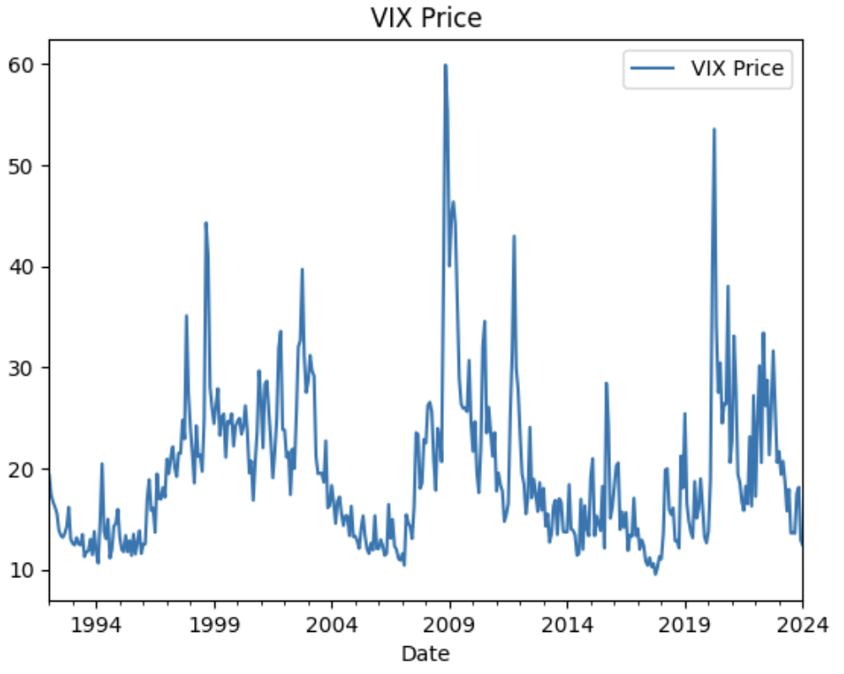
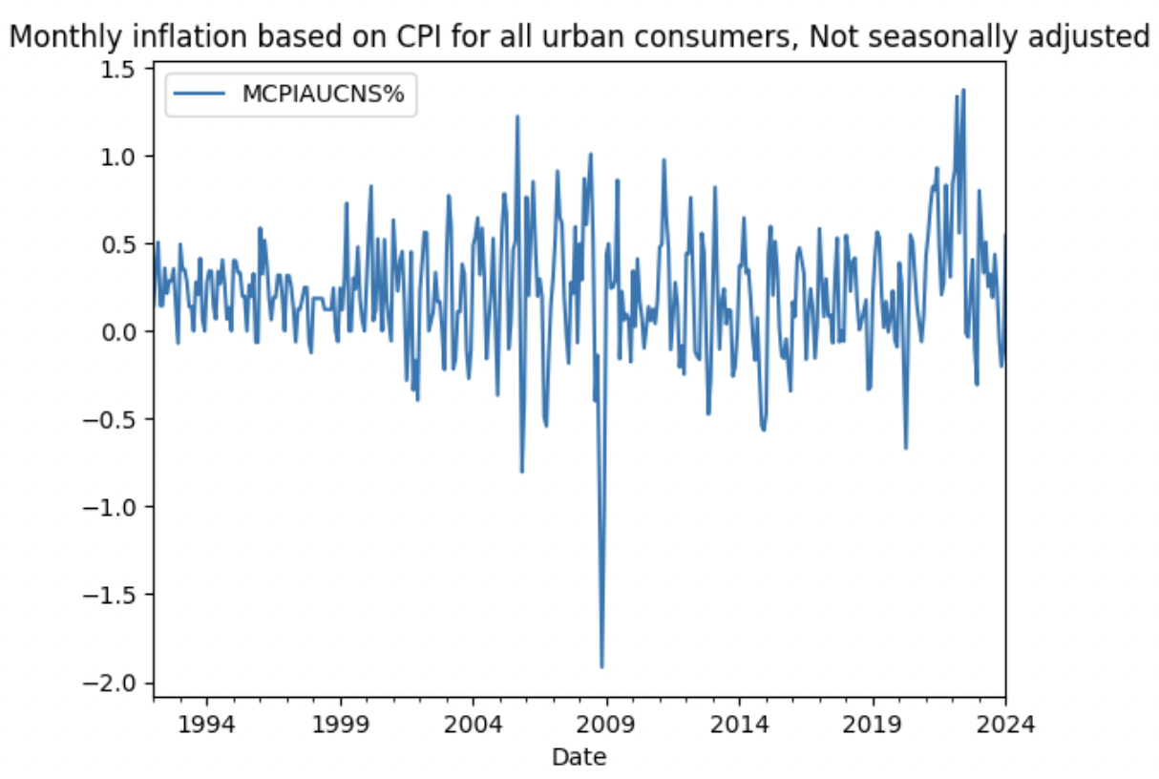
Time Period Selection
The Asian Crisis of 1997; The Financial Crisis of 2008; The COVID of 2020
Time Period Selected: Jan 2000 - Jan 2024

Slide 9
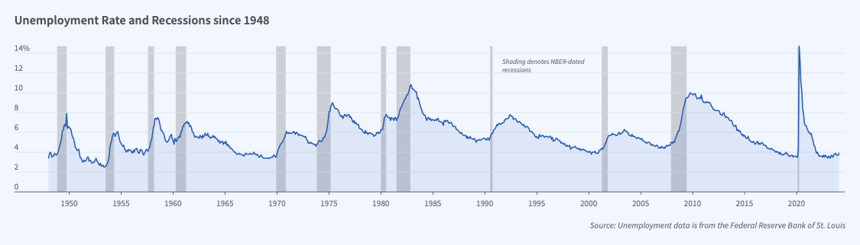
2. Variable Transformation - Binary Variables
US Business Cycle Contractions (recessions)
  March 2001 to November 2001 ⇒ Recession 1
  December 2007 to June 2009 ⇒ Recession 2
  February 2020 to April 2020 ⇒ Recession 3

Slide 10
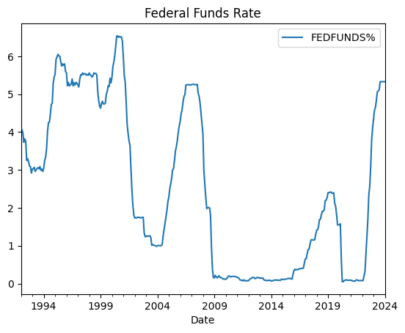
2. Variable Transformation - Stationary Variables
Augmented Dickey-Fuller test
Stationary Variables
  VIX Price
    (p-value 0.000)
  Monthly Inflation
    (p-value 0.014)
  Federal Funds Rate
    (p-value 0.005)

Slide 11
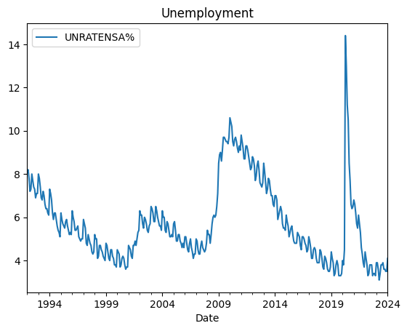
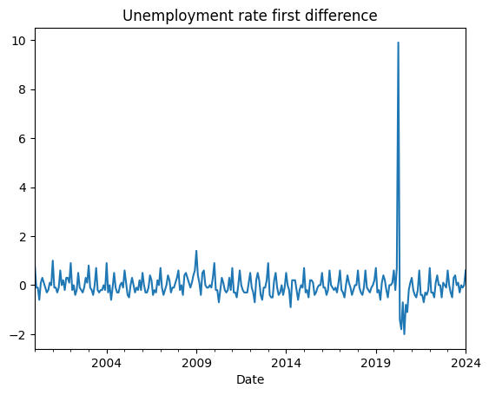
2. Variable Transformation - Stationarity test
Unemployment Rate: First difference (p-value 0.000)

Slide 12
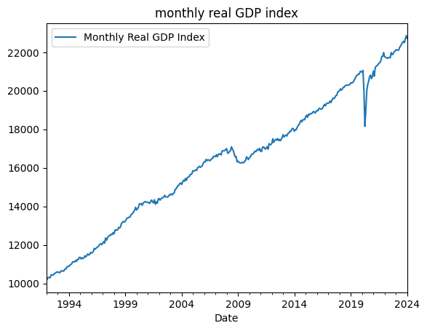
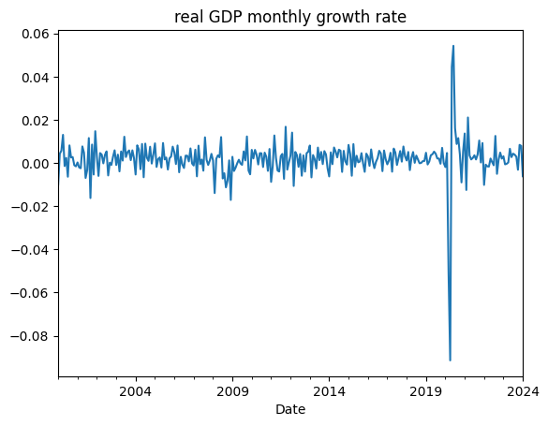
2. Variable Transformation - Stationarity test
Monthly Real GDP Index: Percentage Difference (p- value 0.000)

Slide 13
Model Selection

Slide 14
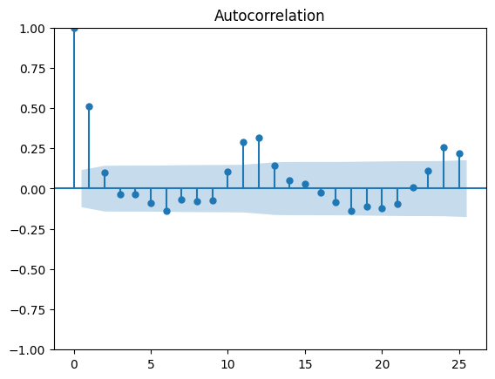
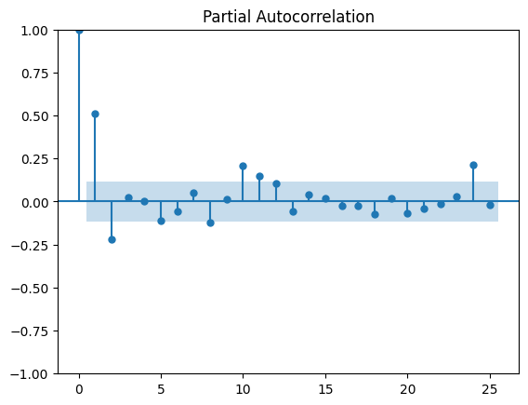
3. Target Variables - Monthly Inflation
ACF: Correlation at lag 1 and lag 2; Cuts off after lag 2

Slide 15
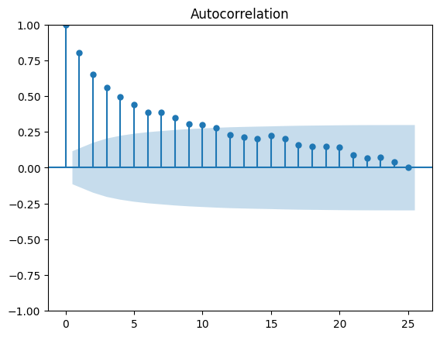
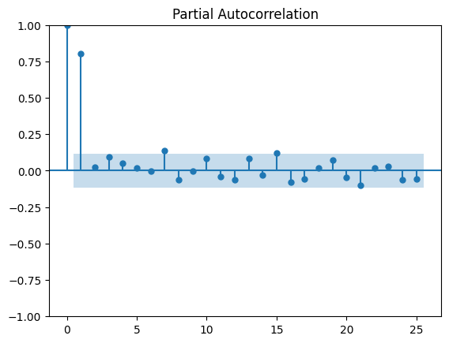
3. Target Variables - VIX Price
PACF: Correlation at lag 1; Cuts off after lag 1

Slide 16
3. Target Variables
 | AR(𝑝) | MA(𝑞) | ARMA(𝑝,𝑞)
ACF | Tails off (Geometric decay) | Significant at lag 𝑞 Cuts off after lag 𝑞 | Tails off (Geometric decay)
PACF | Significant at lag 𝑝 Cuts off after lag 𝑝 | Tails off (Geometric decay) | Tails off (Geometric decay)
Multivariate Version
VARX(𝑝)
VMAX(𝑞)
VARMAX(𝑝,𝑞)

Slide 17
3. Target Variables
VIX Price
AR(1)
Monthly Inflation
MA(2)
 | AR(𝑝) | MA(𝑞) | ARMA(𝑝,𝑞)
ACF | Tails off (Geometric decay) | Significant at lag 𝑞 Cuts off after lag 𝑞 | Tails off (Geometric decay)
PACF | Significant at lag 𝑝 Cuts off after lag 𝑝 | Tails off (Geometric decay) | Tails off (Geometric decay)
Multivariate Version
VARX(𝑝)
VMAX(𝑞)
VARMAX(𝑝,𝑞)

Slide 18
4. Model Selection
Objective: Interaction between 2 series
Task: capture the interactions between Monthly Inflation and VIX Price
Question: “Does one of them help in predicting the other?”
Multivariate Time Series Model with Exogenous Variable:
  VARX(𝑝); VMAX(𝑞); VARMAX(𝑝,𝑞)
Evaluation Criteria: In-sample RMSE and Out-of-sample RMSE
  Training Data (01/01/2000 - 06/01/2023)
  Testing Data (07/01/2023 - 01/01/2024)
Notes:
Avi

Slide 19
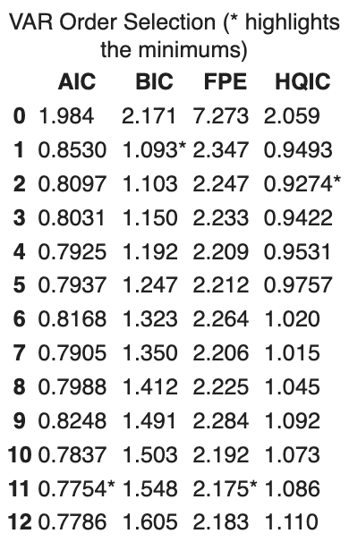
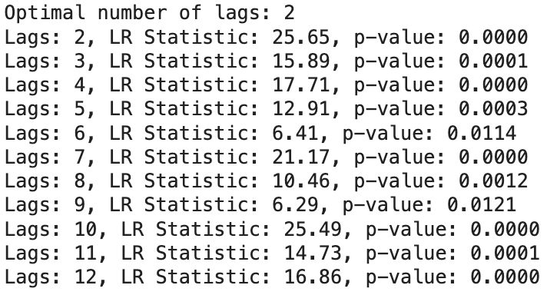
Eg. Lag Selection on VARX(2) with binary variables
Likelihood Ratio Test, AIC, BIC
  Lag 11, Lag 2, or Lag 1
Notes:
Followed by stability test and granger causality test

Slide 20
Model | In-sample RMSE | Out-of-Sample RMSE
VARX(2) without controlling structural break | RMSE (inflation) = 0.3234 RMSE (VIX) = 4.5318 | RMSE (inflation) = 0.2866 RMSE (VIX) = 3.6432
* VARX(2) with binary variable controlling structural break | * RMSE (inflation) = 0.3216 RMSE (VIX) = 4.3640 | * RMSE (inflation) = 0.2905 RMSE (VIX) = 2.9303
VARX(2) without controlling structural break and exogenous variable | RMSE (inflation) = 0.3186 RMSE (VIX) = 4.6374 | RMSE (inflation) = 0.2628 RMSE (VIX) = 5.4253
VARMAX(1,1) with binary variable controlling structural break | RMSE (inflation) = 0.3268 RMSE (VIX) = 4.5651 | RMSE (inflation) = 0.3711 RMSE (VIX) = 2.6311
VARMAX(1,2) with binary variable controlling structural break | RMSE (inflation) = 0.3244 RMSE (VIX) = 4.5622 | RMSE (inflation) = 0.3691 RMSE (VIX) = 2.5593
VMAX(2) with binary variable controlling structural break | RMSE (inflation) = 0.3391 RMSE (VIX) = 4.9554 | RMSE (inflation) = 0.3724 RMSE (VIX) = 2.3937
VMAX(1) with binary variable controlling structural break | RMSE (inflation) = 0.3423 RMSE (VIX) = 5.3491 | RMSE (inflation) = 0.3407 RMSE (VIX) = 2.5391
Notes:
VAR (VS) VARMA (VS) VMA
VAR gives the lowest In sample and out of sample RMSE for inflation
VMA and VARMA give the lowest out of sample RMSE for VIX price
On average, VAR(2) with binary variables gives us a balanced performance taking into account RMSE for both variables

Slide 21
Model | Average In-sample RMSE | Average Out-of-Sample RMSE
VARX(2) without controlling structural break | 2.4276 | 1.9649
* VARX(2) with binary variable controlling structural break | * 2.3428 | * 1.6104
VARX(2) without controlling structural break and exogenous variable | 2.4780 | 2.8441
VARMAX(1,1) with binary variable controlling structural break | 2.4460 | 1.5011
VARMAX(1,2) with binary variable controlling structural break | 2.4433 | 1.4642
VMAX(2) with binary variable controlling structural break | 2.6473 | 1.3831
VMAX(1) with binary variable controlling structural break | 2.8457 | 1.4399
Notes:
VAR (VS) VARMA (VS) VMA
VAR gives the lowest In sample and out of sample RMSE for inflation
VMA and VARMA give the lowest out of sample RMSE for VIX price
On average, VAR(2) with binary variables gives us a balanced performance taking into account RMSE for both variables

Slide 22
Results

Slide 23
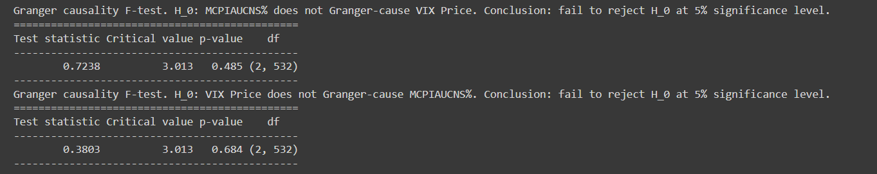
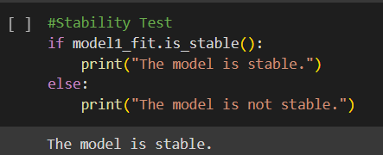
Granger Causality & Stability Test (All Models)
Granger Causality ≠ Causality
Notes:
Ibukun
None of our models showed any signs of granger causality. All were stable so no explosive processes, or cointegration
Granger causality means that the variable isn’t useful for forecasting.
Model performance visual

Slide 24
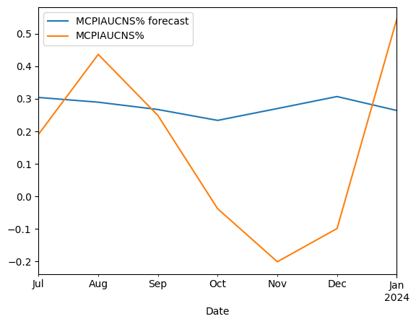
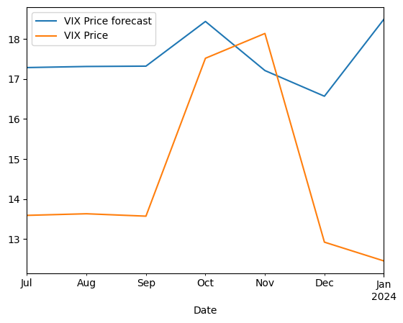
Forecasting (VARX no SB)
Average RMSE: 1.9649
Notes:
Ibukun
Level trend, bad performance on vix

Slide 25
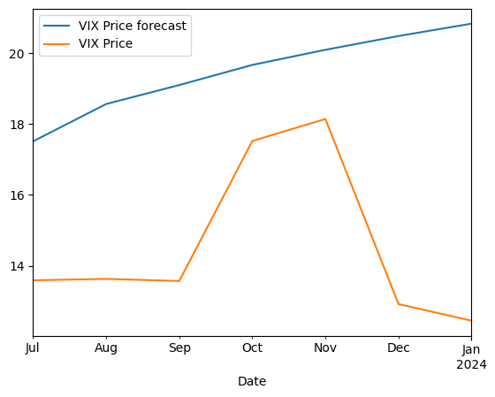
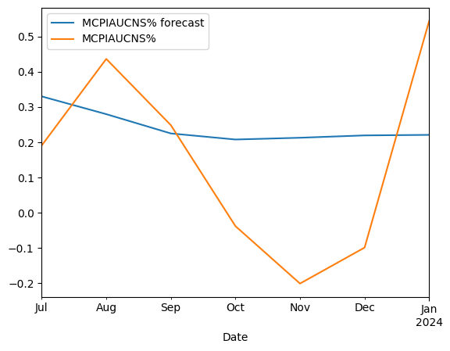
Forecasting (All endogenous, no SB)
Average RMSE: 2.844
Notes:
Ibukun
Worst
Lesson: dont just throw the economy into a linear model and hope it does well

Slide 26
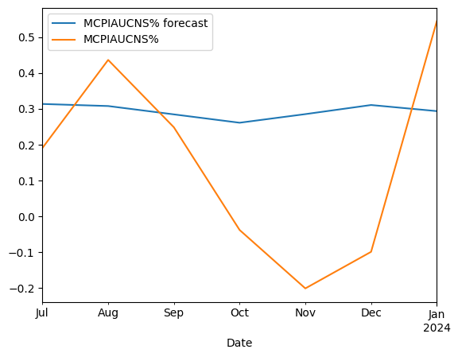
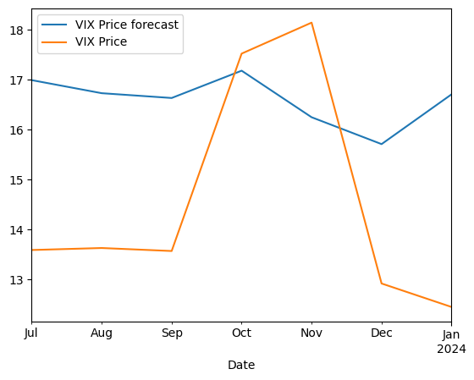
Forecasting (VARX w/ SB)
Average RMSE: 1.6104
Notes:
Ibukun

Slide 27
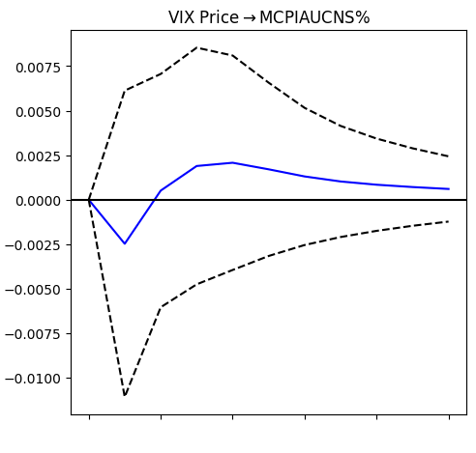
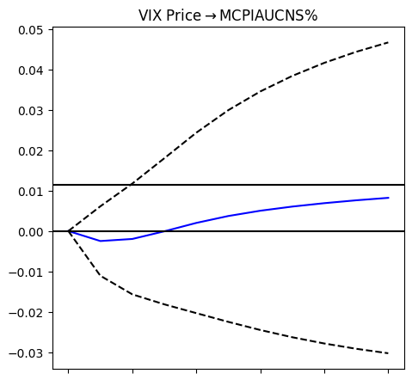
Impulse Response Functions (10 periods)
Standard
Cumulative
Notes:
Ibukun
95% confidence error bands, Asymptotic. More on that later.
Negative to positive. No significant difference from zero

Slide 28
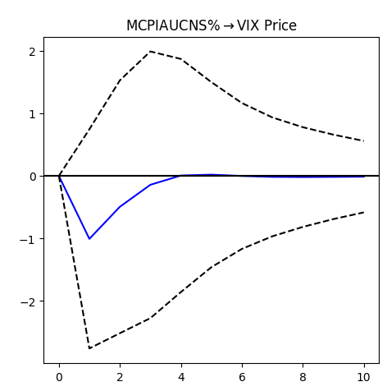
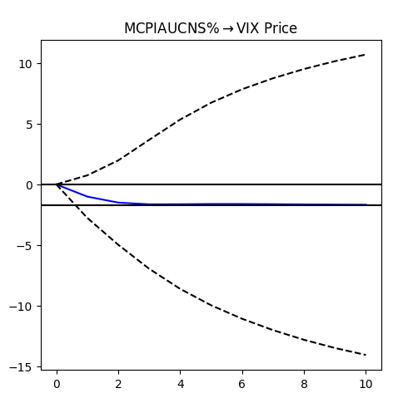
Impulse Response Functions (10 periods)
Standard
Cumulative
Notes:
Ibukun
Negative. Again no significance in either

Slide 29
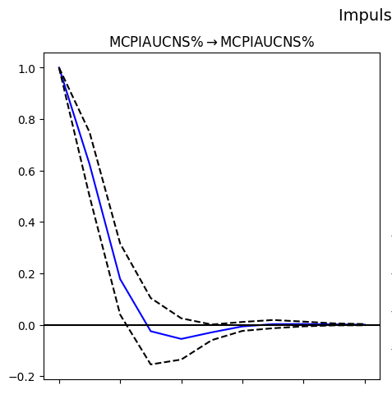
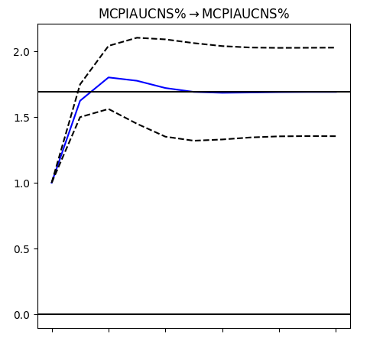
Impulse Response Functions (10 periods)
Standard
Cumulative
Notes:
Ibukun
shocks to inflation seem to dissipate quickly. Result of federal reserves efforts perhaps

Slide 30
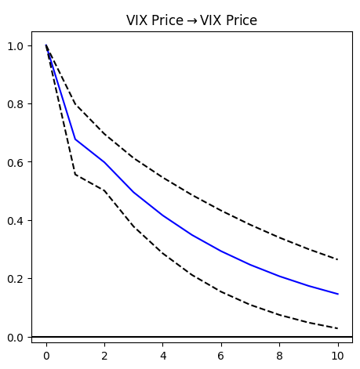
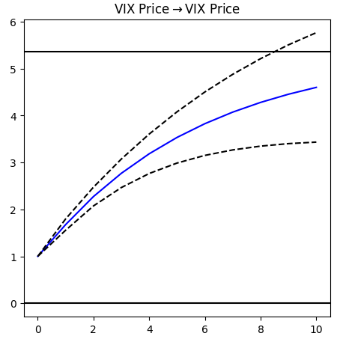
Reduced Form IRFs (10 periods)
Standard
Cumulative
Notes:
Ibukun
Large shocks to VIX remain relevant for extended periods. Shows that calming investors negative sentiments is very difficult due to persistence

Slide 31
Side Note on Standard Errors¹
Benkwitz, Lütkepohl and Neumann (2000) found that asymptotic standard errors may be misleading.
Alternatively, use bootstrap/monte carlo methods.
We use asymptotics because:
  Fachin and Bravetti (1996) & Killian and Chang (2000) found mixed results when comparing the two approaches.
  Less resource intensive.
  MC methods still require asymptotic justification.
  In general, asymptotic performs better but modifications to MC improve performance considerably.
Bayesian methods, primarily Sims and Zha (1999), are also a popular alternative
[1] Econometric Analysis with Vector Autoregressive Models, Lütkepohl (2007)
Notes:
In the spirit of being good scientists, we feel it is important to mention this
We defend the use of asymptotic standard errors for the following reasons:
The marginal cost outweighed the gain during our research
Given we have 280 observations, we feel our sample size is large enough
Beyond scope of this class

Slide 32
Conclusion & Improvements
Conclusion
VIX and inflation show no relationship.
VAR Models show some predictive power regarding the trend of both series but precision is still lacking.
Improvements:
Omitted variables.
Granularity of data.
Relaxing linearity assumption.
Notes:
Ibukun
Granularity of data (Effect may have smoothed out)
Inherent linearity assumption may need to be relaxed. It might not be a good approximation in this case given that with financial data there are a lot of non linear relationships
Exchange raetes
CRB commodities

Slide 33
Thank You
Any Questions?

